Slide 1
Vaccines
Learning objectives
Know several examples of vaccines
Explain how a vaccine works
Evaluate the risks and benefits of vaccines
Starter: Fill in the table
What diseases are children vaccinated against at these ages?
2 months
1 year
3 years
12-13 years
13-18 years
Notes:
Possible diseases include: Whooping cough, polio and flu, MMR (measles, mumps and rubella), tetanus, HPV (Human papilloma virus), diphtheria and polio

Slide 2
Which diseases are children vaccinated against at these ages?
2 months | Diphtheria, tetanus, whooping cough, polio and flu
1 year | MMR (measles, mumps and rubella)
3 years | Pre-school booster: diphtheria, tetanus, whooping cough and polio
12-13 years | HPV (Human papilloma virus)
13-18 years | Teenage booster: diphtheria, tetanus and polio
Notes:
Student Answers

Slide 3
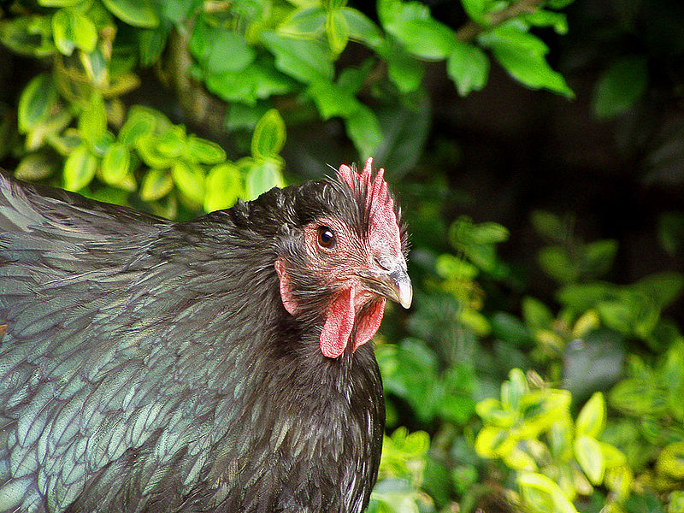
Discuss the following questions:
Have you ever had chicken pox?
Have you ever had chicken pox twice?
Notes:
Image credit: Creative Commons via Wikimedia Commons: http://commons.wikimedia.org/wiki/File:Orpington_chicken.jpg
We don’t get chicken pox twice is because we usually develop immunity to the chicken pox virus after first exposure. This is because we develop antibodies against these conditions.

Slide 4
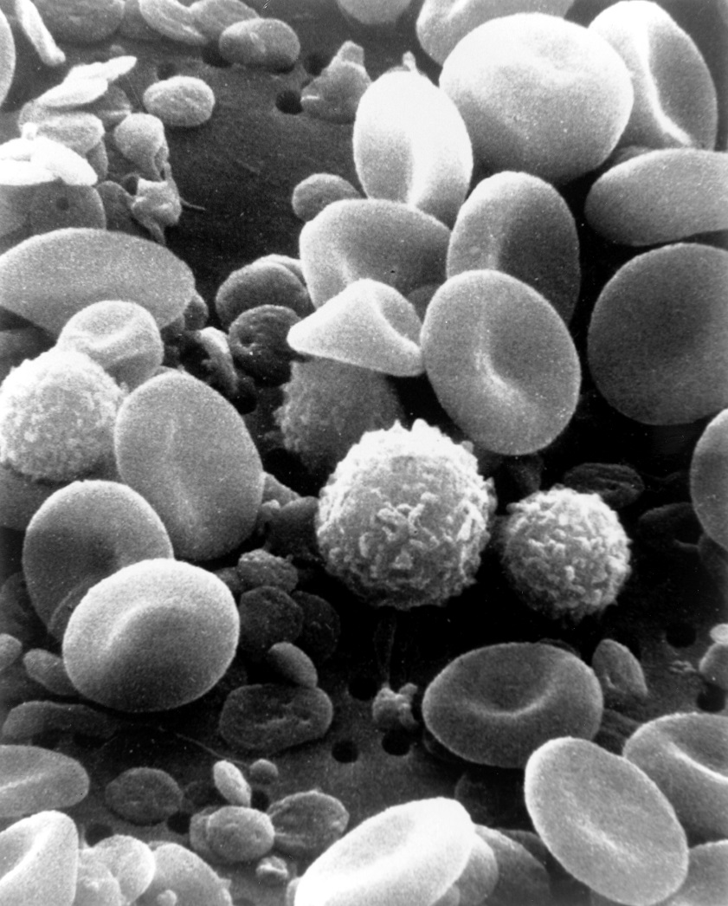
What is immunity?
When our bodies encounter pathogens, our white blood cells create antibodies against the pathogens. This makes them easier for the immune system to destroy.
After the first infection the body remembers how to make the right antibodies, and can make them quickly if the same pathogen is encountered again.
People usually get chicken pox just once because they become immune to the chicken pox virus.
Notes:
Image credit: By Bruce Wetzel (photographer). Harry Schaefer (photographer) (Image and description: National Cancer Institute) [Public domain], via Wikimedia Commons: http://commons.wikimedia.org/wiki/File:SEM_blood_cells.jpg

Slide 5
Put the stages of immunity in the right order
The immune system remembers how to make the right antibodies, and the pathogen is killed more quickly.
The same pathogen tries to infect the person again.
A pathogen like chicken pox virus enters the body.
The white blood cells of the immune system create antibodies, which destroy the pathogens.
The person is now immune to the pathogen, and is unlikely to get the same illness again.
The pathogen secretes antigens, which make the person feel ill.
Notes:
PRINT OFF FOR STUDENTS
Test Tubed
Animals
Health People
Patients
Randomised Trials
Market Release

Slide 6
Answers
2
3
A pathogen like chicken pox virus enters the body.
The pathogen secretes antigens, which make the person feel ill.
1
The white blood cells of the immune system create antibodies, which destroy the pathogens.
The same pathogen tries to infect the person again.
5
4
The immune system remembers how to make the right antibodies, and the pathogen is killed more quickly.
The person is now immune to the pathogen, and is unlikely to get the same illness again.
6
Notes:
Test Tubed
Animals
Health People
Patients
Randomised Trials
Market Release

Slide 7
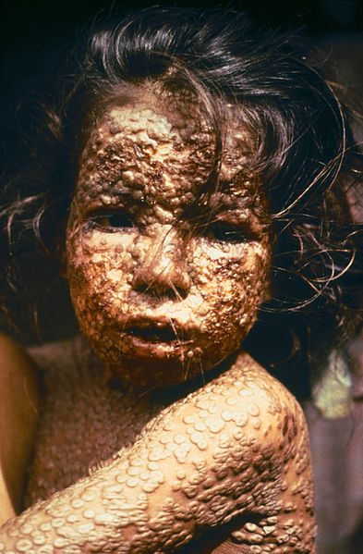
Smallpox
This child has a disease called smallpox, a virus that causes painful fluid-filled blisters to appear all over the body.
30-35% of people infected with smallpox die. In 18th century Europe smallpox killed around 400,000 people every year.
Survivors were often horribly scarred, and in a small number of cases blinded by the disease.
Notes:
Smallpox is now eradicated thanks to a large scale vaccination program.
Image Credit: Centres for Disease Control and Public Health/James Hicks. http://commons.wikimedia.org/wiki/File:Child_with_Smallpox_Bangladesh.jpg

Slide 8
Watch the following video and answer the questions:
https://www.youtube.com/watch?v=JgZwA-39Dj4
What ‘old wives tale’ was Edward Jenner interested in?
How did he test whether the tale was true?
How did Jenner know that cowpox was safer than smallpox?
Using your knowledge of immunity, explain why catching cowpox protects you against smallpox.
Jenner had created the first vaccine against a disease. By 1979 smallpox had been completely eradicated, due to a successful global vaccination programme.
Notes:
That milkmaids never got smallpox. He found that milkmaids did catch cowpox.
He took pus from a cowpox sore and innoculated a boy with it. The boy caught a mild case of cowpox. After a short time Jenner injected the boy with smallpox, and the boy did not get sick.
Cowpox causes sores, but does not kill people.
Cowpox virus has similar antigens to smallpox virus. When the body creates antibodies to the cowpox virus, those antibodies also work on the smallpox virus because the two diseases are very similar.

Slide 9
What is a vaccine?
Vaccines create immunity without making you sick
Vaccines contains
dead pathogens, or
live but weakened pathogens, or
parts of the pathogen
The white blood cells respond to the vaccine as if it were a disease by creating antibodies.
Quick questions:
Why do we need different vaccines for different diseases?
New flu vaccines must be made every year. Why?
Notes:
Answers:
Different strains of flu virus appear at regular intervals that have different antigens. Memory cells do not recognise them, and so cannot produce antibodies.
Measles, mumps and rubella virus strains do not change.

Slide 10
Active versus passive immunity
Vaccines create active immunity: the body creates its own antibodies.
If a person is already sick, they can be given an injection of antibodies to help them fight the disease. This is called passive immunity. The protection is quick, but doesn’t last long.
Passive immunity can also occur when mothers transfer antibodies to babies across the placenta and in breast milk.

Slide 11
Fill in the table
 | Active immunity | Passive immunity
Who produces the antibodies?
How quickly does it work?
How long does it last for?
When might it occur?
Notes:
PRINT THIS.

Slide 12
Fill in the table
 | Active immunity | Passive immunity
Who produces the antibodies? | The infected person | A different person or an animal
How quickly does it work? | Slowly | Quickly
How long does it last for? | Long time | Short time
When might it occur? | After illness or vaccination | When a baby receives antibodies from its mother

Slide 13
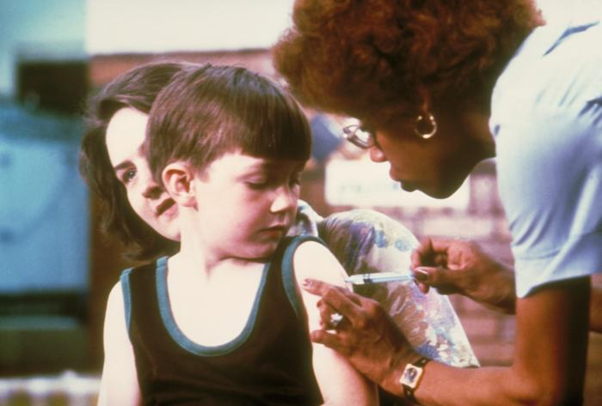
Think. Pair. Share.
What would happen if we stopped vaccinating people against disease?
Notes:
Image credit: By United States Department of Health and Human Services [Public domain], via Wikimedia Commons: http://commons.wikimedia.org/wiki/File:Vaccination.jpg

Slide 14
Measles, Mumps and Rubella (MMR)
Since 1991 children have been given two doses of the MMR vaccine, to give them the most effective protection against measles, mumps, and rubella. However, in the 1980s most children were only vaccinated once, leading to a mumps epidemic in the UK in 2004 amongst teenagers who had only been given a single vaccination.
In 1998 surgeon Andrew Wakefield claimed that the MMR vaccine caused autism. His study has now been completely discredited, but not before it led to a decrease in the number of parents allowing their children to be vaccinated. As a result, an outbreak of measles occurred in Wales during 2013. Over 1000 people fell sick and one person died.
Notes:
Andrew Wakefield was struck off the medical register and is barred from practising medicine in the UK.

Slide 15
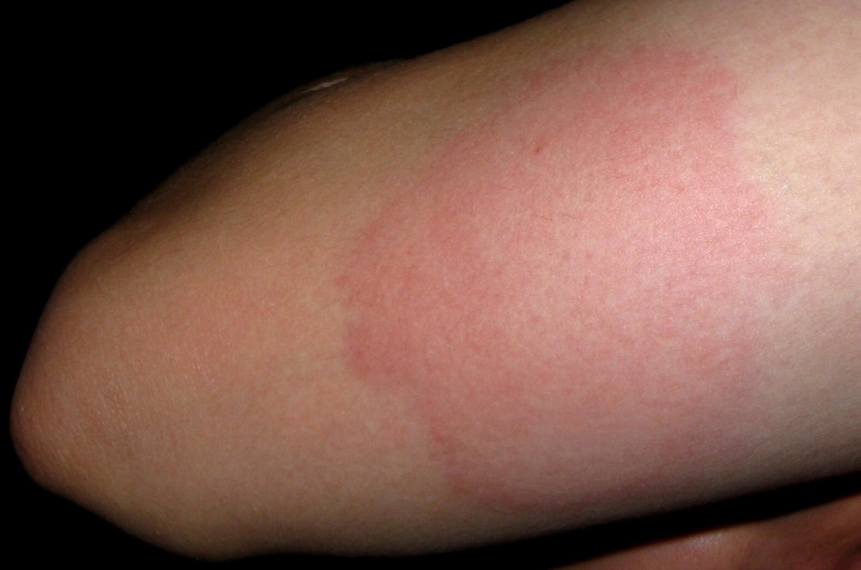
How do we know that vaccines are safe?
All drugs, including vaccines, can have side-effects. We have to balance the risk of taking the vaccine against the risk of catching a disease.
Scientists test new vaccines on animals to make sure that they are safe for humans.
Side effects, if any, are rare and usually minor, but like any drug there is the risk of severe allergic reactions.

Slide 16
Plenary
Why can you catch a cold like flu twice?
What type of immunity is produced when
Antibodies are transferred from mother to baby during breastfeeding
A person has chicken pox and is now immune to the disease
Why might some people feel ill after having a vaccine?
Notes:
The plenary is ordered by ability. All students should complete 1. Most should manage 2 and some should manage 3.
Different strains of the flu
A) Passive B) Active
They may contract a weakened form of a live attenuated virus

Slide 17
Resources

Slide 18
Starter
Starter
What diseases are children vaccinated against at these ages?
2 months
1 year
3 years
12-13 years
13-18 years
What diseases are children vaccinated against at these ages?
2 months
1 year
3 years
12-13 years
13-18 years

Slide 19
Starter Scaffold
5-in-1: Diptheria, tetanus, whooping cough, polio and flu | Pre-School booster: diphtheria, tetanus, whooping cough and polio
MMR (measles, mumps and rubella) | HPV (human papilloma virus)
Teenage booster: diphtheria, tetanus and polio
5-in-1: Diptheria, tetanus, whooping cough, polio and flu | Pre-School booster: diphtheria, tetanus, whooping cough and polio
MMR (measles, mumps and rubella) | HPV (human papilloma virus)
Teenage booster: diphtheria, tetanus and polio
Notes:
Student Answers

Slide 20
Put the drug development stages in the right order
Drugs are tested on large numbers of patients. Half are given the new drug, half receive a placebo.
Drugs are tested on patients to check that the drug works to treat the disease in people.
Drugs are tested in test tubes and using computers to try to assess if they may be dangerous to humans.
Drugs are tested on a few healthy young men to ensure they are safe and to check for side effects.
Drugs receive a license so doctors can prescribe them to patients
Drugs are tested in two animal species to check that they are not toxic and to find the best dosage
Notes:
Test Tubed
Animals
Health People
Patients
Randomised Trials
Market Release

Slide 21
Answers
Drugs are tested in test tubes and using computers to try to assess if they may be dangerous to humans.
2
3
1
Drugs are tested in two animal species to check that they are not toxic and to find the best dosage
Drugs are tested on a few healthy young men to ensure they are safe and to check for side effects.
Drugs are tested on patients to check that the drug works to treat the disease in people.
5
4
Drugs are tested on large numbers of patients. Half are given the new drug, half receive a placebo.
Drugs receive a license so doctors can prescribe them to patients
6
Notes:
Test Tubed
Animals
Health People
Patients
Randomised Trials
Market Release

Slide 22
Fill in the table
 | Active immunity | Passive immunity
Who produces the antibodies?
How quickly does it work?
How long does it last for?
When might it occur?
Notes:
PRINT THIS.

