Slide 1
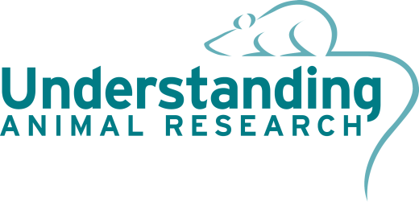
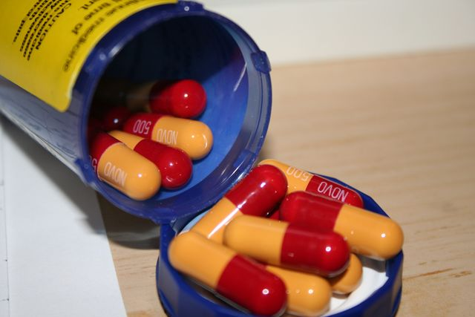
Developing medicines
Learning objectives
Know the stages of drug development
Explain why animals are used in research
Analyse why new drugs may fail
Starter:
List 5-10 medications that you have taken.
What symptoms were they treating?
Notes:
Vaccines, antibiotics, painkillers etc.
Creative Commons Image Credit: Wikimedia - http://commons.wikimedia.org/wiki/File:NOVAMOXIN_antibiotic.jpg

Slide 2
What information do you need before you take a medicine?
Write down 3 things that you would want to know about a medicine that you were about to take.
Notes:
Answers on next slide

Slide 3
What information do you need before you take a medicine?
How often should I take it?
What are the side effects?
What is the dose?
Are there any side effects?
How much should I take?
Should I take it with food/water?
Will it make me better?
Is it poisonous?
Is it toxic?
Is it safe?
Will it cure me?
Does it work?
Is it addictive?

Slide 4
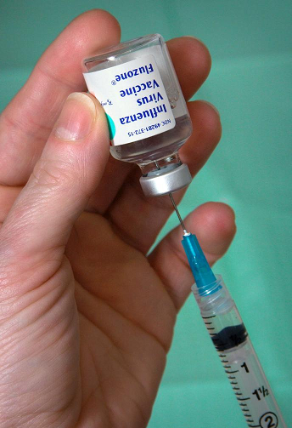
What information do you need before you take a medicine?
Think, Pair, Share
You are faced with a new, untested drug
Pick one of the questions below.
How could you find the answer to your question?
What is the correct dose?
Are there any side effects?
Does it work?
Is it safe?
Notes:
All answers revolve around trialling it on people, animals, cells or computers.
Creative Commons Image Credit: Wikimedia - http://upload.wikimedia.org/wikipedia/commons/f/f6/Fluzone_vaccine_extracting.jpg
Think Pair Share = 1 minute silent thinking, 1 minute discussing with partner, then feeding back to class.

Slide 5
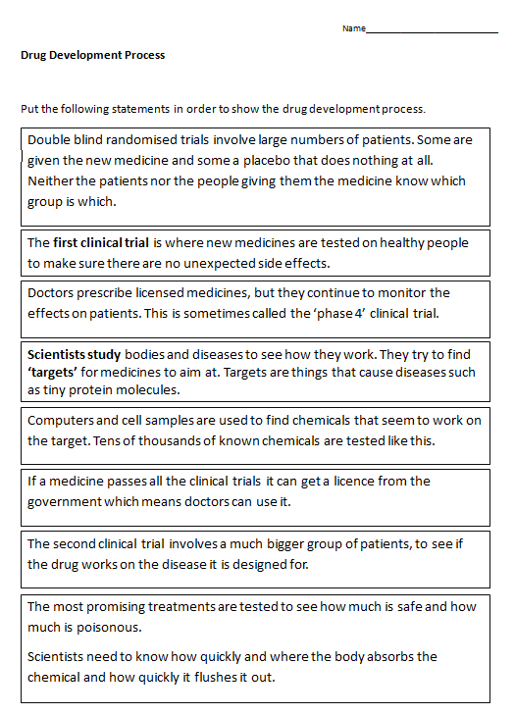
The Drug Development Process
Look at the Drug Development Process worksheet
Put them in the correct order, first to last.
Animals are used in two of the stages. Which stages do you think these are?
Notes:
See Last Slide for a powerpoint version of the word document on this page. Alternatively print off the “Drug Development Process” worksheet

Slide 6
Correct Answers
Scientists study bodies and diseases to see how they work. They try to find ‘targets’ for medicines to aim at. Targets are things that cause diseases such as tiny protein molecules.
Computers and cell samples are used to find chemicals that seem to work on the target. Tens of thousands of known chemicals are tested like this.
The most promising treatments are tested to see how much is safe and how much is poisonous. Scientists need to know how quickly and where the body absorbs the chemical and how quickly it flushes it out.
The first clinical trial is where new medicines are tested on healthy people to make sure there are no unexpected side effects.
The second clinical trial involves a much bigger group of patients, to see if the drug works on the disease it is designed for.
Double blind randomised trials involve large numbers of patients. Some are given the new medicine and some a placebo that does nothing at all. Neither the patients nor the people giving them the medicine know which group is which.
If a medicine passes all the clinical trials it can get a licence from the government which means doctors can use it.
Doctors prescribe licensed medicines, but they continue to monitor the effects on patients. This is sometimes called the ‘phase 4’ clinical trial.
Notes:
This is the correct order of the drug development process

Slide 7
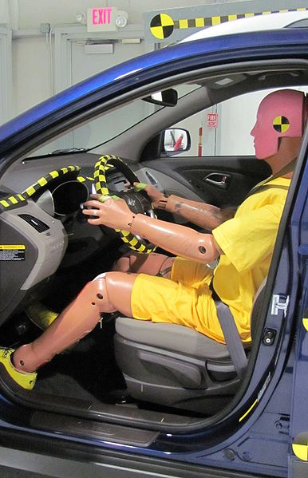
What is a scientific model?
Models are used in scientific research when we cannot study the real thing. They help us to predict what will happen.
There are 3 kinds of models used in developing a new medicine:
Non-animal/non-human
Living humans
Living animals
CLICK FOR VIDEO
Watch up to 2:15 on video
Notes:
Click the “click for video” button then stop video at 2.15
Creative Commons Image Credit: Wikimedia - http://commons.wikimedia.org/wiki/File:IIHS_crash_test_dummy_in_Hyundai_Tucson.jpg
Crash test dummies are a model for humans used in testing the safety of a car – it would be unethical to use humans to test a car’s ability to withstand an accident. Video found here: https://www.youtube.com/watch?v=Jj5QlYlE66w
Advise watching up until 2:15 . Higher ability groups may wish to extend their learning by watching the rest of the video

Slide 8
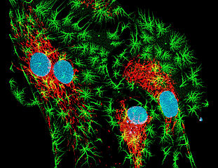
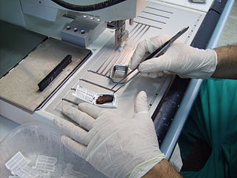
Non-animal and non-human models
Computers can be programmed with information about a disease and a treatment to try and predict what will happen when the treatment is given.
Tissue samples show the effect that a treatment has on a group of cells. These cells are alive but are not part of a whole organism.
The effects of a medicine can also be looked at in bacteria.
Computer model of artery
Tissue sample
Notes:
Non-animal methods include microdosing humans, computer models (often based on animal data), cell cultures (from humans or animals), CT/MRI/PET scans of human patients
Creative Commons Image Credit: http://commons.wikimedia.org/wiki/File:Fibroblastid.jpg?uselang=en-gb and http://commons.wikimedia.org/wiki/File:Tissue_processing_-_Paraffin_inclusion_of_a_histological_sample.jpg

Slide 9
Non-animal and non-human models
Think, Pair, Share
Consider each of the following models. Why might they not provide all the information needed to confirm if a new drug is safe and effective for us?
Computer model of how a drug is metabolised in the body
A human tissue sample to study if a new chemical causes cancer (test if the drug is carcinogenic)
Yeast cells used to check if a new drug is toxic to parts of a cell.
Notes:
Computer model only as good as data that made it, more to drug effects than metabolism
Human tissue isn’t whole organism so can’t see how cancer spreads or whether other organs are affected (maybe other parts of body help to fight off cancer)
Yeast cells are not the same as human cells, many different human cells that react differently
Creative Commons Image Credit: Wikimedia - http://upload.wikimedia.org/wikipedia/commons/f/f6/Fluzone_vaccine_extracting.jpg
Think Pair Share = 1 minute silent thinking, 1 minute discussing with partner, then feeding back to class.

Slide 10
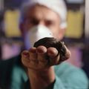
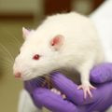
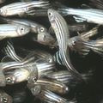
Animal models
Even if we give a new medicine to some human cells, this cannot tell us how it will affect the whole body. We also need to know if the medicine will reach the part of the body it needs to.
Living animals, most commonly mice, rats and fish, are used to see how a medicine affects a whole body. It can tell us about the toxicity and will also indicate what dosage is necessary for humans.
The government requires new medicines to be tested on two species. Why do you think this is?
Notes:
Creative Commons Image Credit: Understanding Animal Research
Two species used increase chances of undesired side effect being spotted. Makes researchers twice as sure about correct human dose. Prevents some unexpected single-specie immunity complicating the research

Slide 11
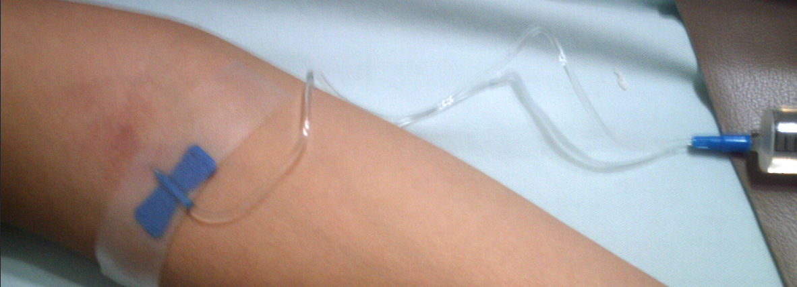
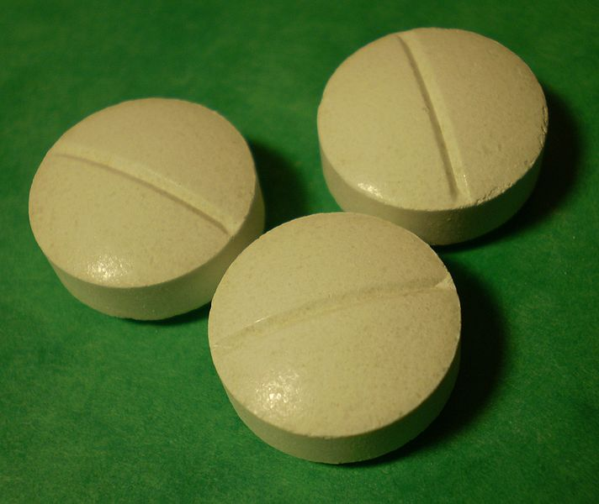
Human models
In the clinical trial stages of developing a new medicine, small groups of humans are used as a model for other humans. We cannot test a medicine on every human so we use the tests on these groups to predict the effects in everyone else.
Some patients will receive the drug and some will receive a placebo (sugar pill). The patient does not know which he has been given; this is called a blind trial.
Notes:
Creative Commons Image Credit: Wilfredor at http://commons.wikimedia.org/wiki/File:Injection_23.JPG and
Kulmalukko http://commons.wikimedia.org/wiki/File:Magnesium_tablets.jpg

Slide 12
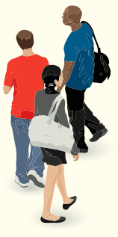
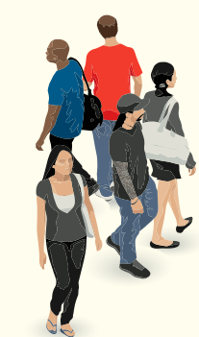
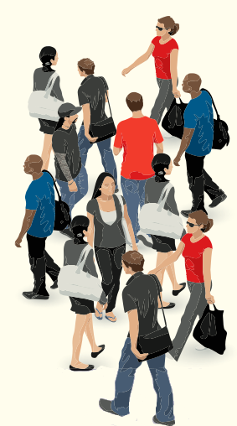
Human models
Stage I
Testing at low doses on healthy volunteers. Usually young males
Stage II
Testing on ill patients to test efficacy of drug and calculate appropriate dosages
Stage III
Testing on a large number of patients to gather data from larger populations
Notes:
Image Credit: Istockphoto/Jamie Farrant

Slide 13
Key Words
Placebo – a fake medicine given to one group of people to check that they aren’t just feeling better because they think they are getting a medicine
Blind trial – a trial where the patient doesn’t know if they are getting the real drug or a placebo
Double-blind trial – a trial where neither the patient or the doctor giving them the medicine knows whether they are getting the real drug or a placebo
What advantages does a double-blind trial have?
Notes:
Two animals increase information and one must be a larger mammal which is more similar to humans.
Creative Commons Image Credit: Wilfredor at http://commons.wikimedia.org/wiki/File:Injection_23.JPG

Slide 14
Plenary
Name two non-animal models.
Explain why a new medicine is tested in animals before humans.
Why might a medicine which passes Stage I and Stage II clinical trials fail during Stage III?

Slide 15
Resources

Slide 16
Drug Development Process
Put the following statements in order to show the drug development process.
Double blind randomised trials involve large numbers of patients. Some are given the new medicine and some a placebo that does nothing at all. Neither the patients nor the people giving them the medicine know which group is which.
The first clinical trial is where new medicines are tested on healthy people to make sure there are no unexpected side effects.
Doctors prescribe licensed medicines, but they continue to monitor the effects on patients. This is sometimes called the ‘phase 4’ clinical trial.
Scientists study bodies and diseases to see how they work. They try to find ‘targets’ for medicines to aim at. Targets are things that cause diseases such as tiny protein molecules.
Computers and cell samples are used to find chemicals that seem to work on the target. Tens of thousands of known chemicals are tested like this.
If a medicine passes all the clinical trials it can get a licence from the government which means doctors can use it.
The second clinical trial involves a much bigger group of patients, to see if the drug works on the disease it is designed for.
The most promising treatments are tested to see how much is safe and how much is poisonous.
Scientists need to know how quickly and where the body absorbs the chemical and how quickly it flushes it out.
Notes:
Hidden Slide – Photocopy this if there if you do not have the word document associated with this lesson plan

