Slide 1
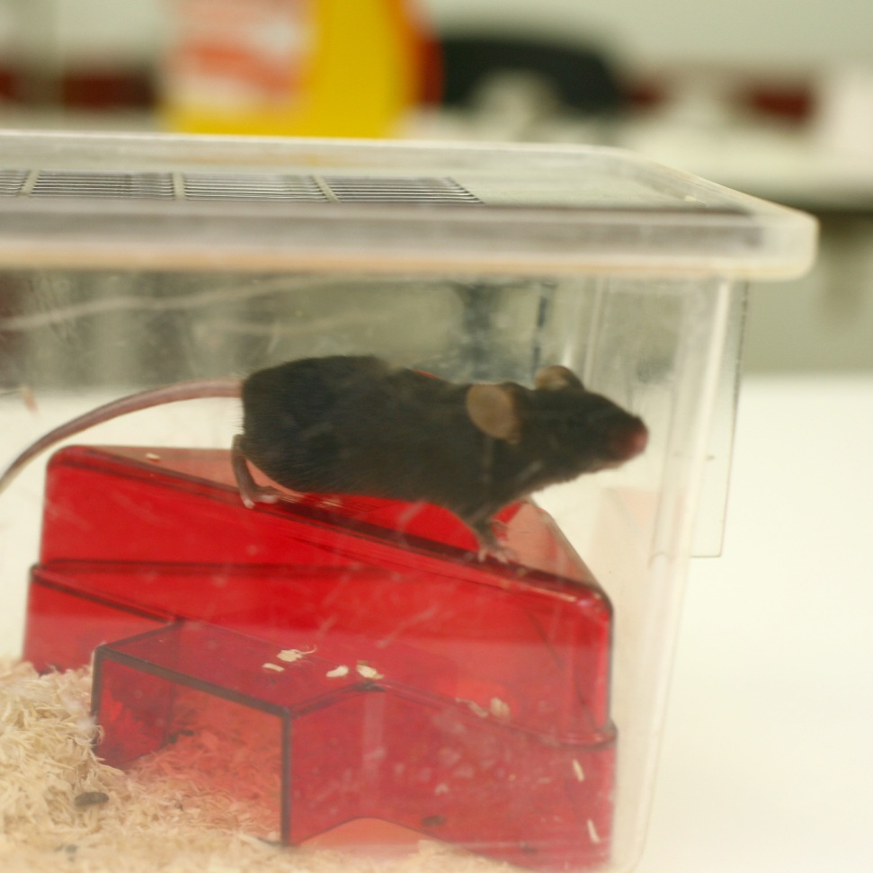
Animal Research and Alternatives
Learning objectives
Know basic facts of animal research
Explain why animal models are used
Assess whether the 3Rs are moral
Starter:
What do you think when someone says “animal testing” or “animal research”
Notes:
Animal research is the correct term for all use of animals in research. Animal testing tends to mean safety testing drugs, which is only a small proportion of all animal use in bioscience. Photo Credit: www.understandinganimalresearch.org.uk

Slide 2
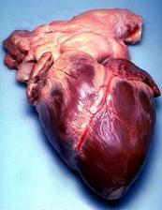
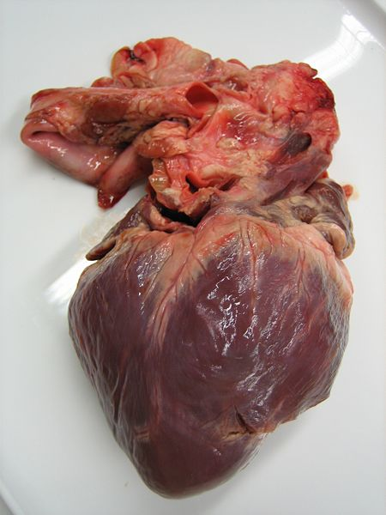
Why are animals used?
Researchers aim to understand how our body functions (physiology) and the diseases that affect us (pathology).
They must study living systems and the effect that diseases have on them – this often involves research that would not be ethical to carry out on humans, so animals are used.
Despite the difference in appearance between humans and animals they have a very similar biology (they are anatomically similar). Even mice and men are around 99% genetically similar.
Notes:
Top image is a human heart, bottom image is a pig heart – note the similarities Images are Creative Commons from Wikipedia

Slide 3
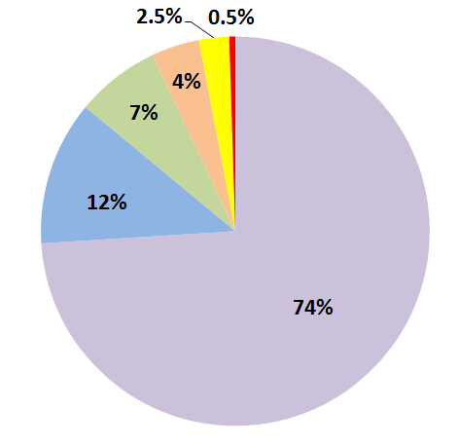
Which Percentage Applies To Which Animals?
Fish
Birds
Rats
Mice
Reptiles / Amphibians
Other Mammals
Notes:
Answers on next slide

Slide 4
Reptiles / Amphibians
Other Mammals
Rats
Fish
Mice
Birds
Notes:
Dogs and cats together account for under 0.5%, monkeys account for less than 0.1%

Slide 5
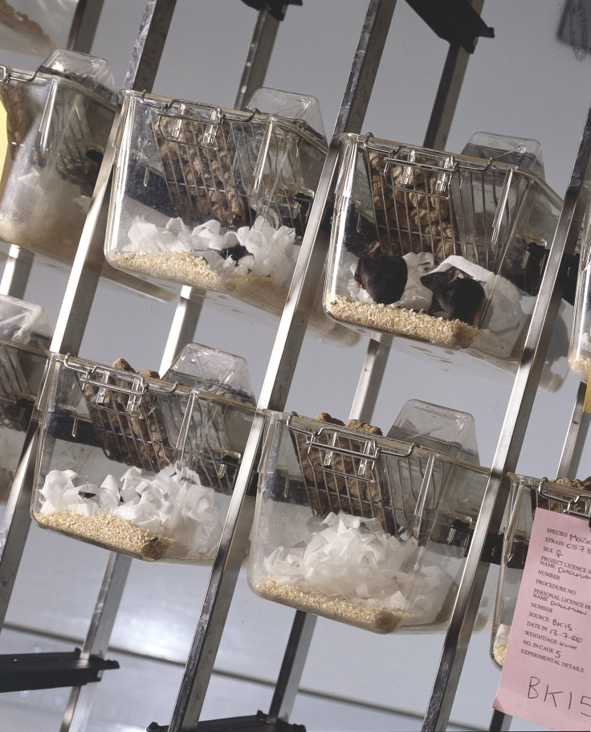
Pop Quiz – Question 1
How many procedures were carried out in 2020?
290,000 procedures
2,900,000 procedures
29,000,000 procedures
Notes:
(B) 3.79 million
Photo Credit: www.understandinganimalresearch.org.uk

Slide 6
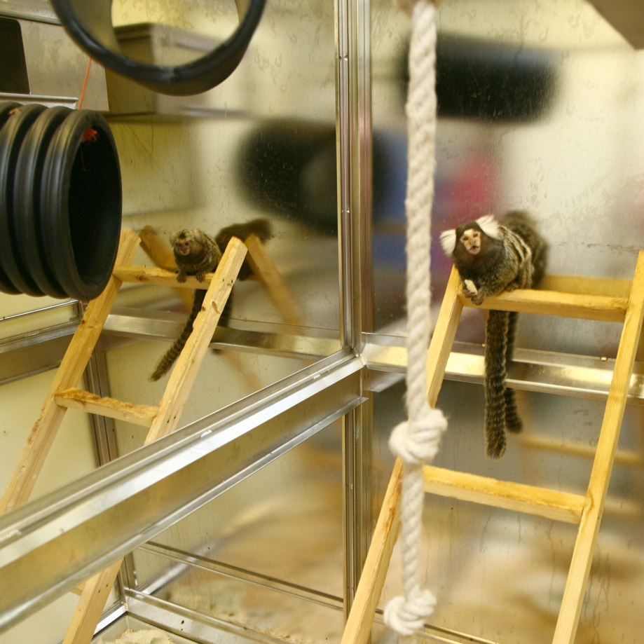
Pop Quiz – Question 2
What proportion of research animals are primates?
0.1%
1%
10%
Notes:
0.1%
Photo Credit: www.understandinganimalresearch.org.uk

Slide 7
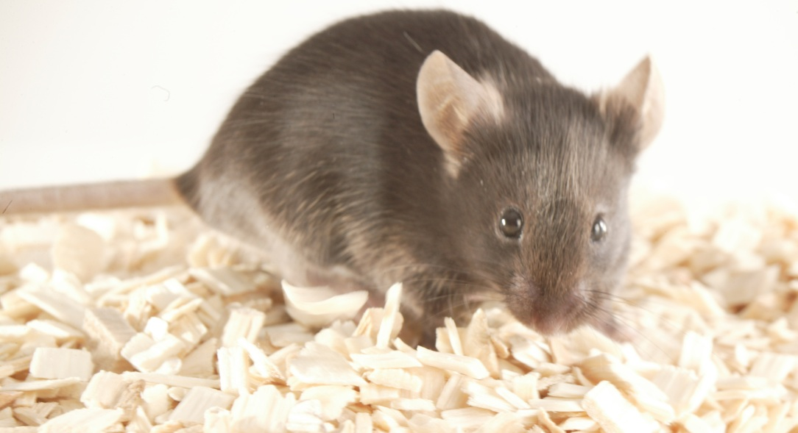
Pop Quiz – Question 3
How many animals are used to test cosmetics each year?
None
50,000
1.2 million
Notes:
None – it’s been banned
Photo Credit: www.understandinganimalresearch.org.uk

Slide 8
Pop Quiz – Question 4
Which government department is responsible for animal welfare in labs?
Department for Environment, Food and Rural Affairs (DEFRA)
Department for Business, Innovation and Skills (BIS)
Home Office
Notes:
(C) Home Office – they are seen as neutral compared with potential bias for and against animal research by DEFRA and BIS
Photo Credit: Home Office Website

Slide 9
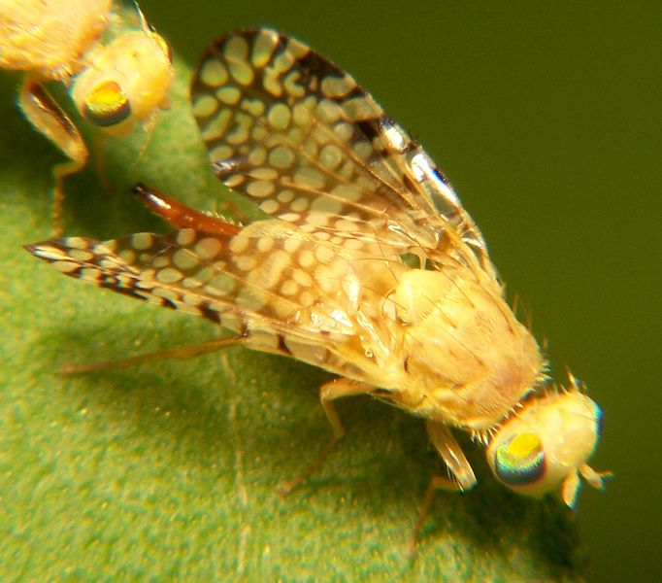
Pop Quiz – Question 5
Which of the following species are not used in medical research?
Fruit Flies
Chimpanzees
Goats
Notes:
(B) Research on all great apes, including chimpanzees and gorilas, was banned in 1986.
Photo Credit: Understanding Animal Research

Slide 10
Pop Quiz – Answers
(B) 2.9 million procedures were carried out in 2020 (slightly fewer than usual due to Covid)
(A) <0.1%, or about 2,200 primates are used in research, mainly into diseases of the brain
(A) Cosmetic testing was banned in the UK in 1998
(C) The Home Office is responsible for inspecting laboratories
(B) The use of great apes for research was banned in 1986.
Notes:
There are more procedures than animals used as some animals may be used more than once.
0.054% of animals used are primates. This accounts for around 0.07% of procedures as primates may often be used more than once
great apes include chimpanzees, orang-utans, gorillas and bonobos

Slide 11
There are different regulations regarding research on different animals. Why do you think this is? Comparing two animals, write down how you think the regulations on animal welfare will differ.
Species you could discuss:
Fruit Flies
Mice
Fish
Cows
Birds
Dogs
Monkeys
Points to consider:
Cage sizes
Cage enrichment (toys etc.)
Housing animals together
Playtime
Veterinary checks
What research can be done
Notes:
Examples:
Bigger animals require bigger enclosures. Primates need the ability to climb upwards. Birds need space to fly.
Pigs will need more hardy toys than mice (for which enrichment be a toilet roll tube). Pigs often play with metal chains. Wheels are often used for mice.
For animals which are more cognitively advanced it is more important to house them together. However, some animals are more prone to fighting each other and will need more careful attention to how they are socially housed.

Slide 12
The 3Rs
The 3Rs are principles of good science designed by scientists to improve animal welfare and scientific accuracy.
Refinement – Finding ways of making animals’ lives better in labs, this can include toys for animals or better training for technicians
Reduction – Using as few animals as possible to get good results
Replacement – Using non-animal alternatives wherever they exist
Notes:
Stressed animals provide more variable results than non-stressed ones (just like humans), so keep stress levels low is important for scientific accuracy.
Refinement covers anything aimed at making the lives of animals within labs better e.g. training a monkey to stand and calmly take an injection so it doesn’t need to be restrained.

Slide 13
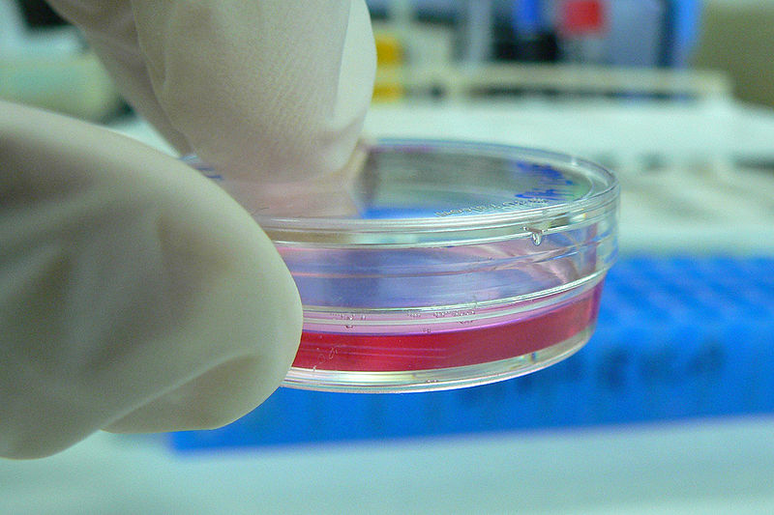
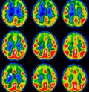
Alternatives
Scientists use many ways to try to replace animals used in research. These include using cell cultures, computer modelling and human studies.
Researchers must, by law, use these techniques if they would be as effective as using animals.
Notes:
Often, non-animal methods complement rather than replace animal research. So computer models use animal data and cell cultures may be taken from animals.
Creative Commons Image of Petri Dish from Wikicommons. Author was Kaibara87.
Understanding Animal Research image of brain scan.

Slide 14
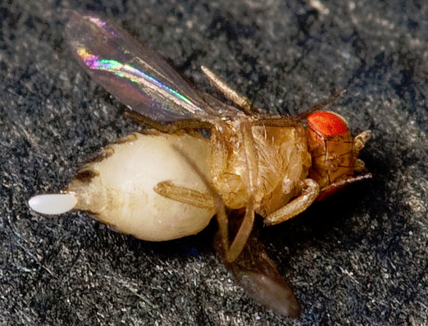
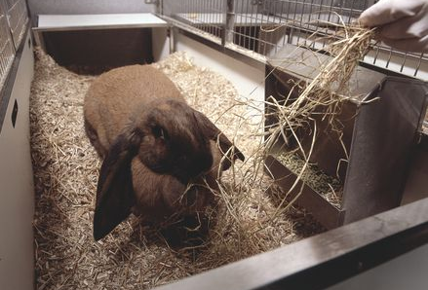
Alternatives
Researchers also try to use the “lowest” type of animal possible for their experiment – perhaps a fish instead of a sheep or a fruit fly instead of a mouse.
Why do you think scientists try to replace animal use? Why use “lower” animals – do you agree with this idea?
or
Notes:
First question is about replacing animal use altogether. Using mice instead of monkeys would be regarded as enrichment provided that net suffering was expected to fall as a result.
Creative Commons Images from WikiCommons.

Slide 15
How the 3Rs are used
Watch the following two videos taken inside animal research facilities and try to identify as many ways as you can that the 3Rs are being used.
e.g. Refinement: the lab technicians are trained to handle the animals carefully
http://www.youtube.com/watch?v=nzjA2aWZ7CA
http://www.youtube.com/watch?v=A8ASyPT-F0g
Notes:
Examples include: dog treats (refinement), noninvasive scanning techniques (replacement), clicker training (refinement), lab techs playing with dogs (refinement), using rats rather than monkeys (reduction), social housing of animals (refinement)

Slide 16
Plenary
Give two examples of how the 3Rs are used in research
In 3 sentences explain why we use animals for research
If you could make a 4th “R”, what would it be and why?

Slide 17
Resources

