Slide 1
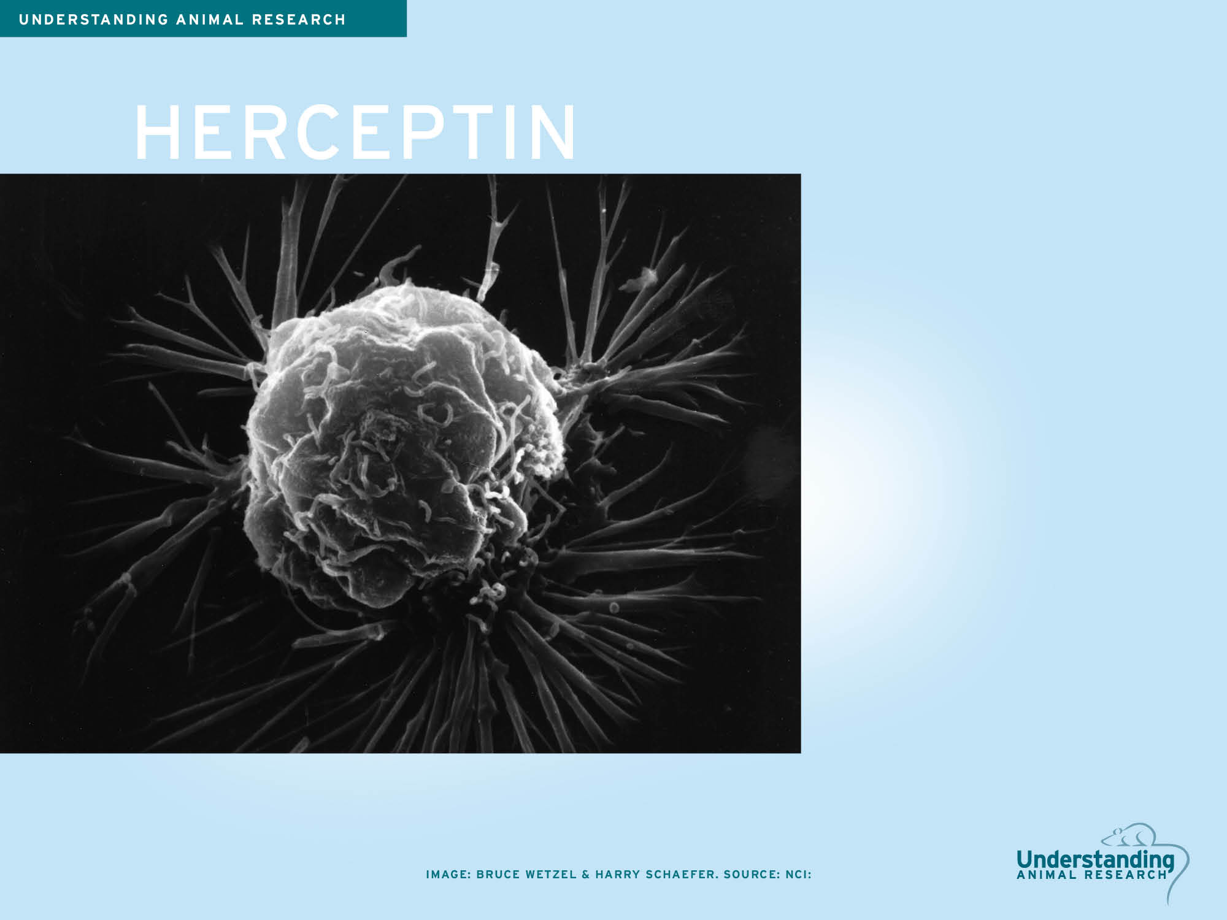
Worldwide, 1.6 million new cases of breast cancer are diagnosed each year, leading to over half a million deaths.
40 years ago in the UK, the five-year survival rate following diagnosis of breast cancer was 50%. Today that figure is 80% thanks to advances in treatment and screening.
One of these advances is Herceptin, a breast cancer drug that reduces the chance of the cancer coming back by over a third. Herceptin was developed using rats, mice, hamsters and macaques.

Slide 2
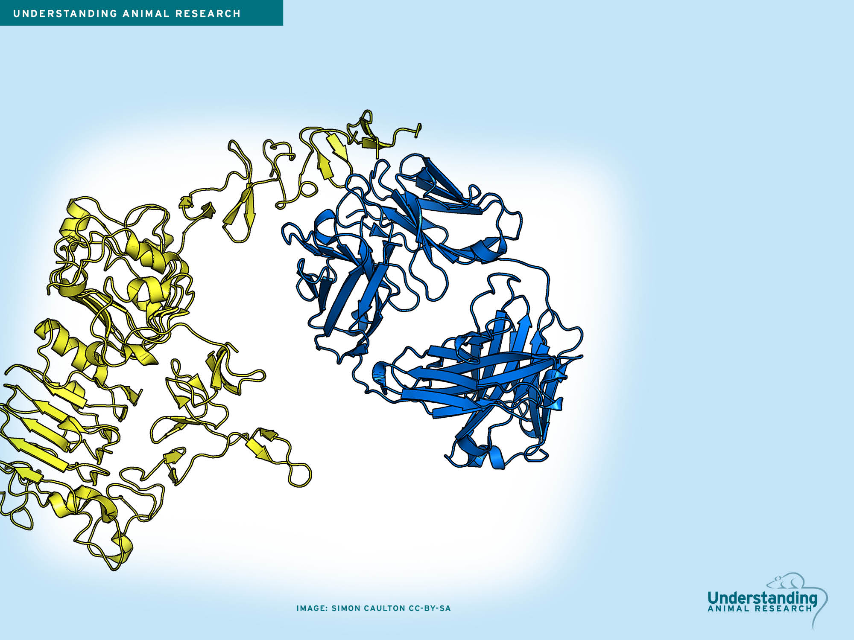
HERCEPTIN
Herceptin was the first monoclonal antibody used to successfully treat cancer. Antibodies are a type of protein produced by the immune system that attaches itself tightly to a specific target. Herceptin is designed to attach to a protein known as HER2.

Slide 3
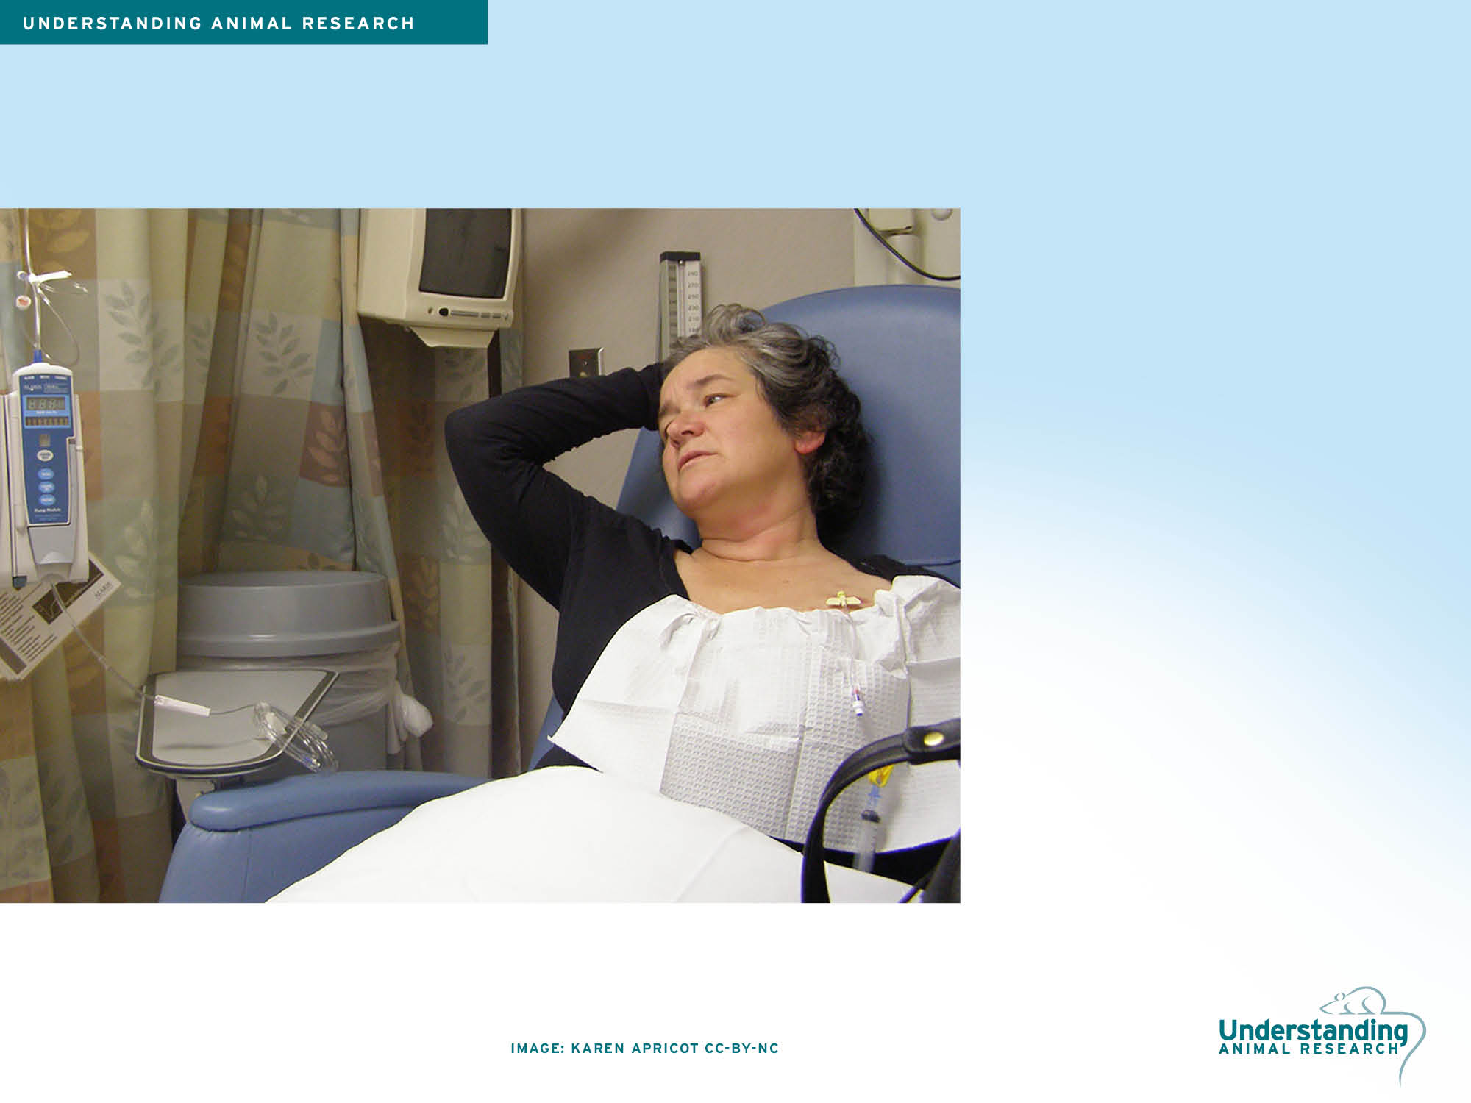
HERCEPTIN
HER2 makes cancer cells grow and replicate faster. Herceptin prevents HER2 from working properly and causes the cancer cells to die. However, this only works for patients whose cancer has high levels of HER2 protein. These are known as HER2-positive cancers and make up around one in five breast cancers.
Herceptin was originally just used to treat breast cancer in its later stages, but is now applied to early stage breast cancer as well. It is given alongside chemotherapy and halves the risk of the cancer coming back.

Slide 4
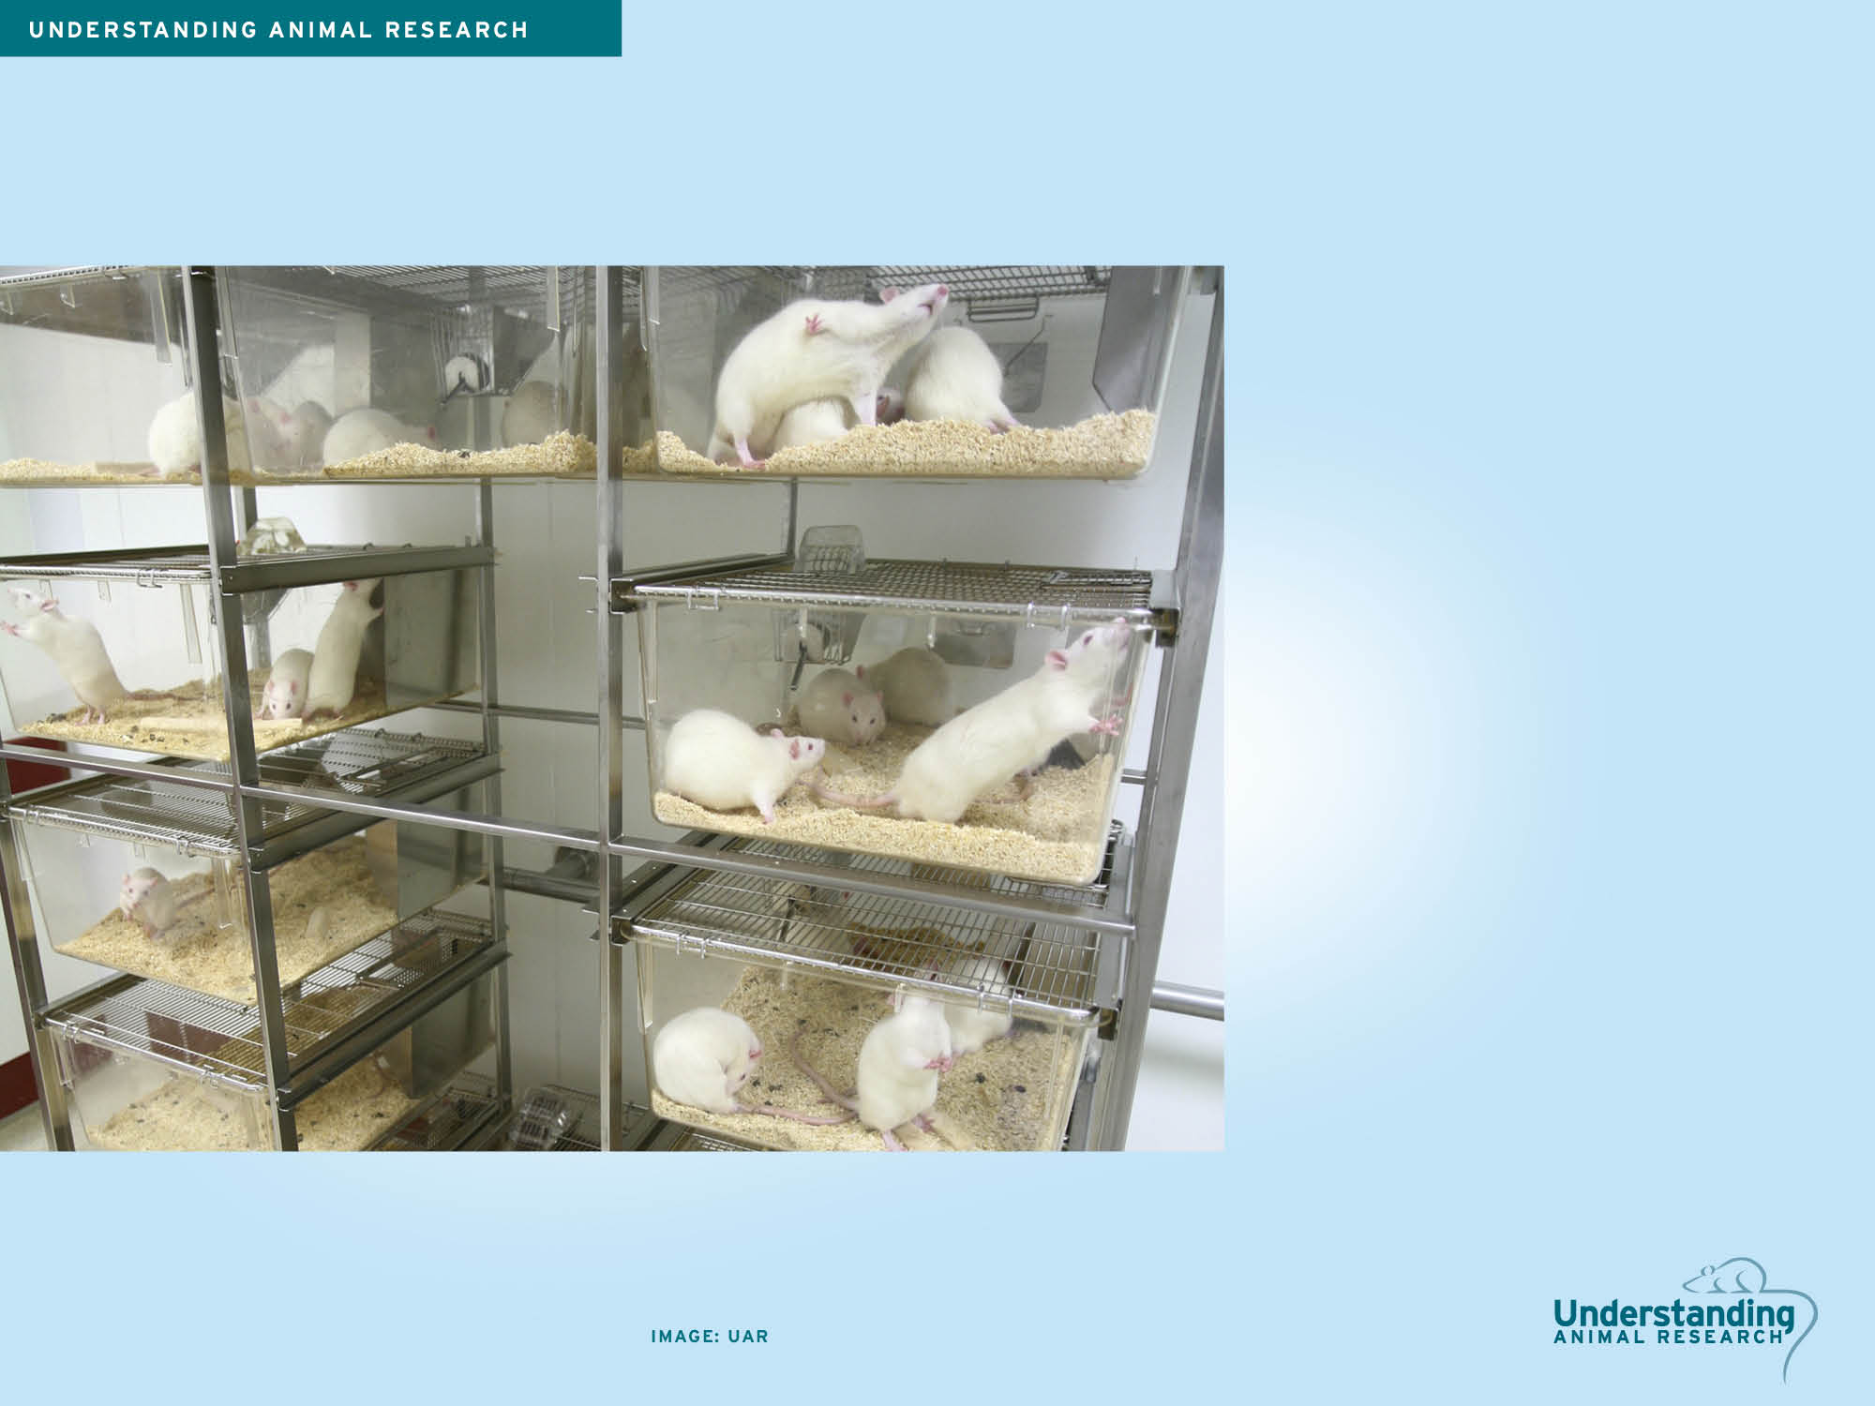
HERCEPTIN
The HER2 protein was discovered in 1982 in neurological tumours of rats.
In 1985, the first monoclonal antibodies to target against HER2 in mice showed they could reduce tumour growth and prolong survival.

Slide 5
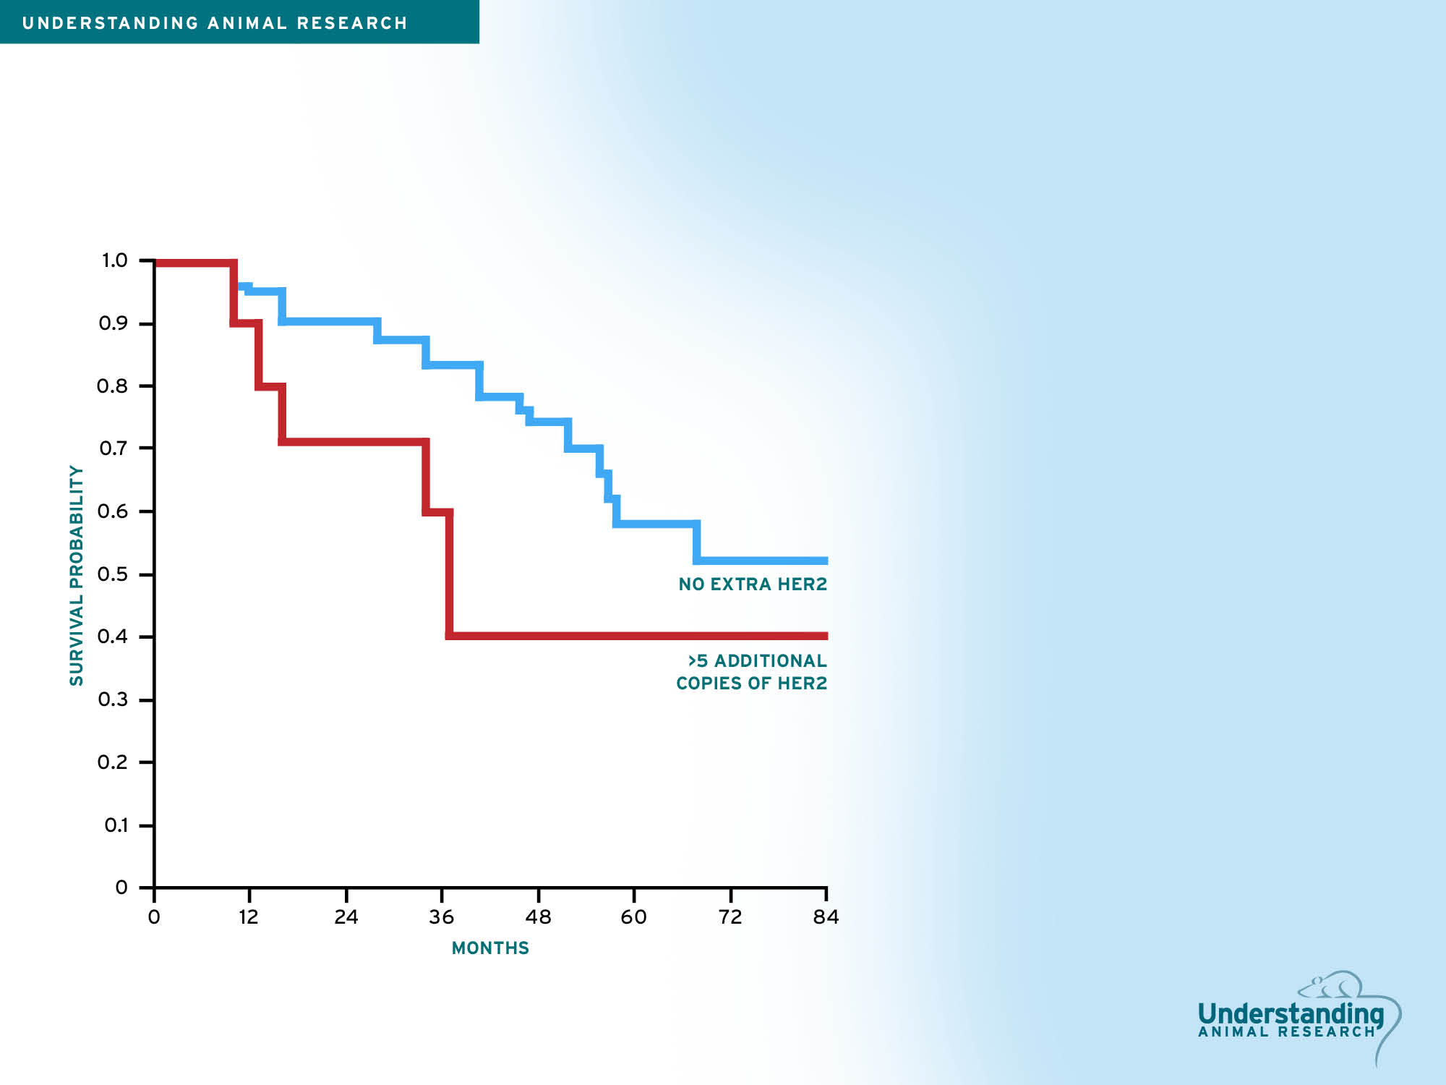
HERCEPTIN
In 1987 researchers showed that higher levels of HER2 in women with breast cancer is linked with a lower survival rate. This meant a monoclonal antibody could work in humans just as it did in mice.

Slide 6
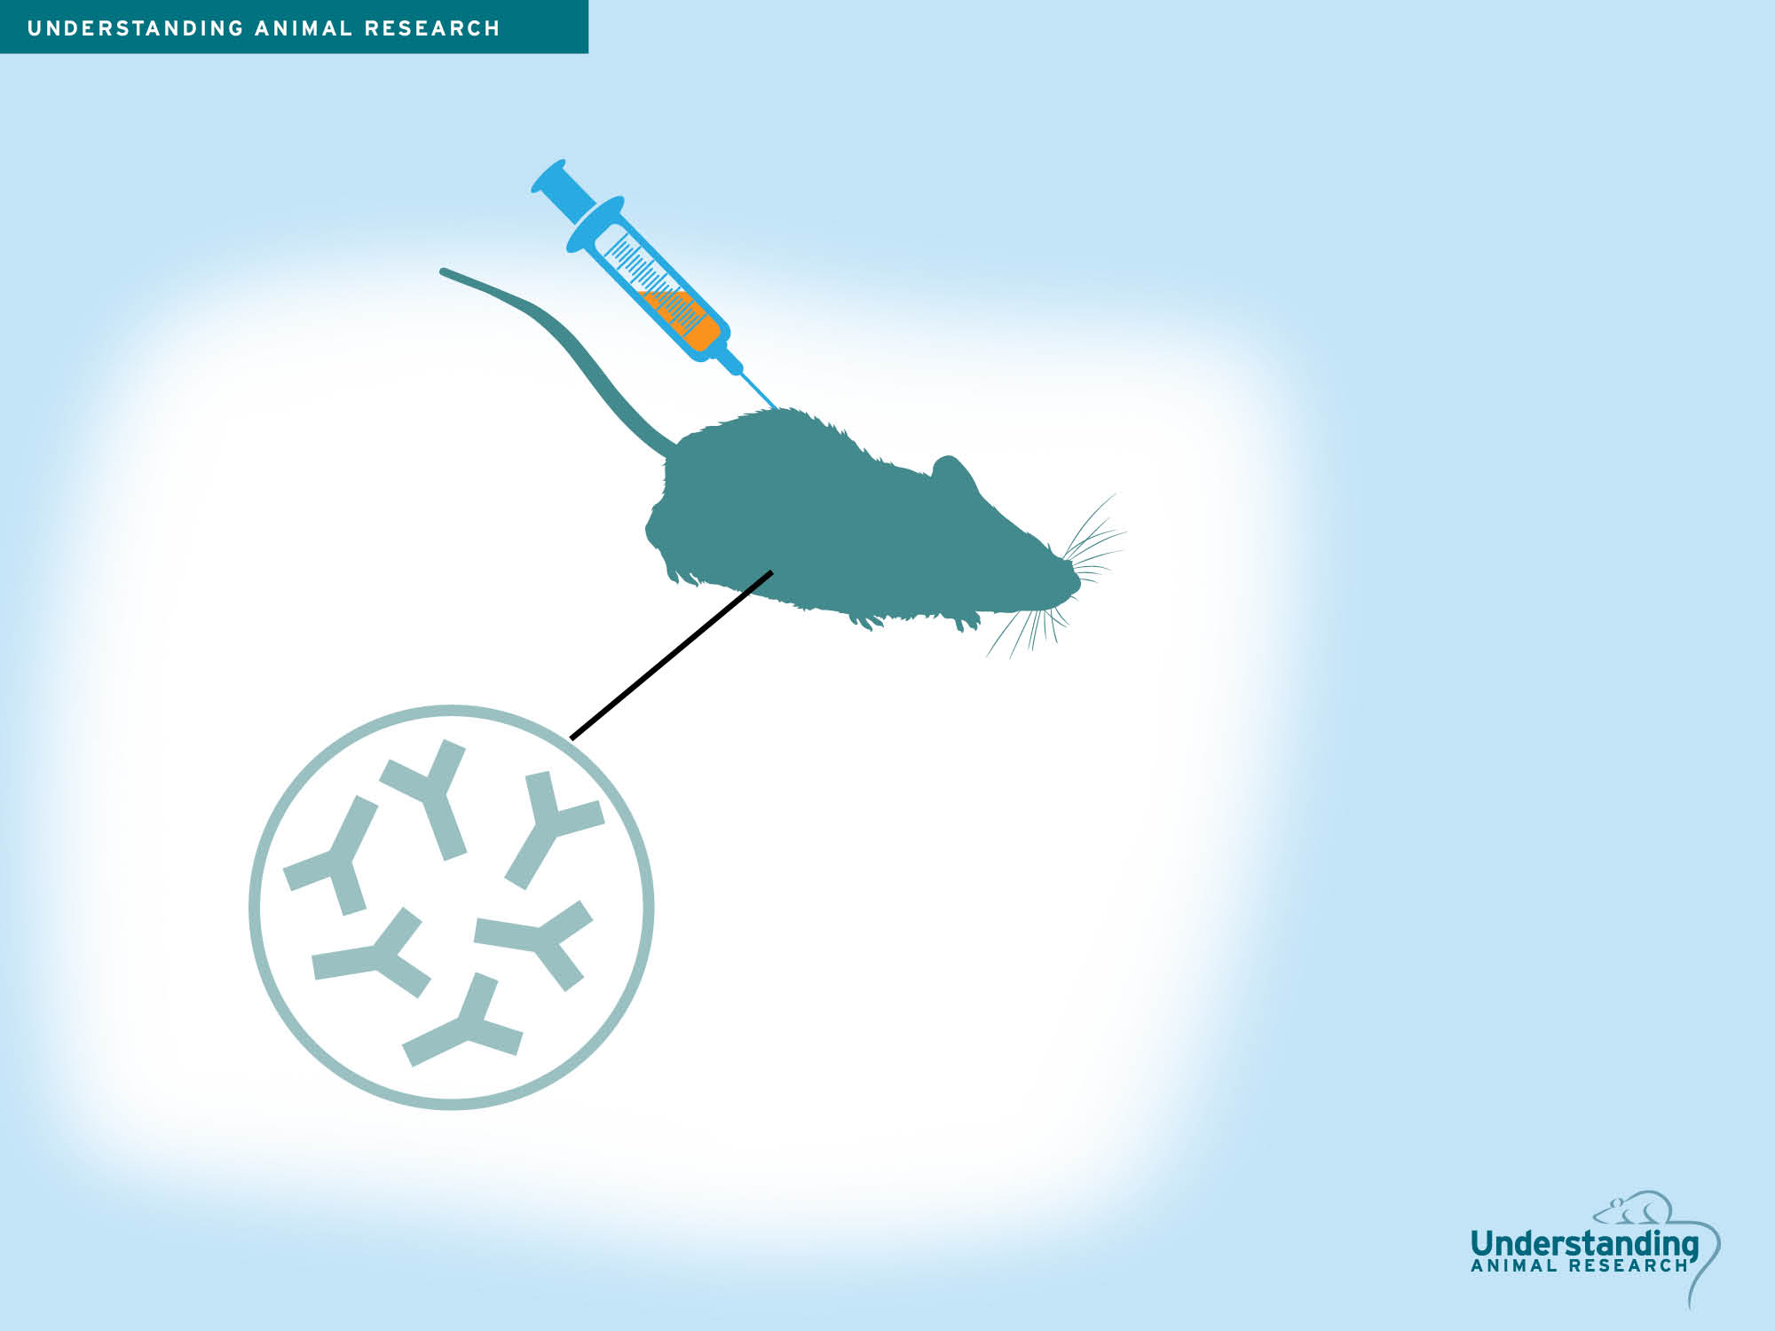
HERCEPTIN
To develop an antibody treatment to target HER2, researchers begin by injecting HER2 into a mouse. The mouse’s immune system then tries to get rid of the HER2 protein by developing antibodies against it. Antibodies are Y-shaped molecules that specifically target foreign material in our bodies.

Slide 7
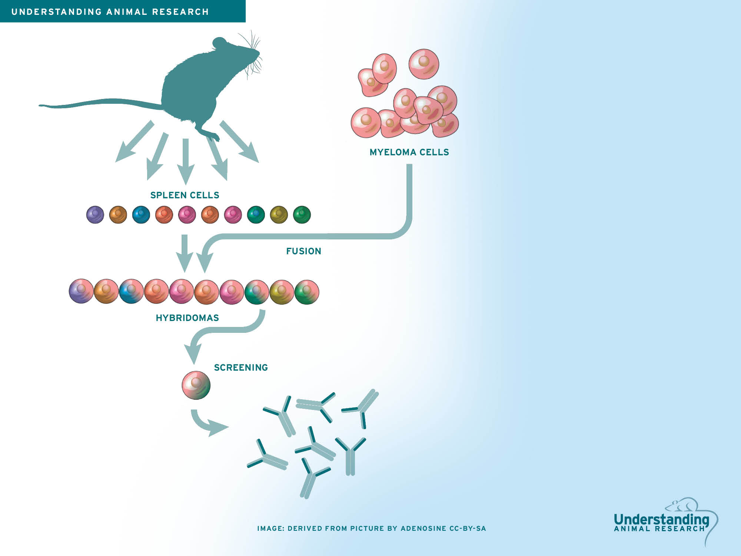
HERCEPTIN
The B-cells that manufacture these antibodies were extracted from the mouse’s spleen. These cells, like all healthy cells, have a limited lifespan. This means that they cannot be grown in the lab long enough to produce sufficient antibodies for medical testing. To get around this, the spleen cells were fused with special human myeloma cells. These myeloma cells can replicate indefinitely and are regularly used by scientists for research.
The fused cells are called hybridomas. Once the cells have grown enough, they are screened to find a cell that produces an antibody targeting HER2 specifically. This is the hallmark of monoclonal antibodies: they are produced from a single original cell. This means that there is no mixture of different types of antibodies and so all of the antibodies given to the patient will work in the same way, reducing side effects.

Slide 8
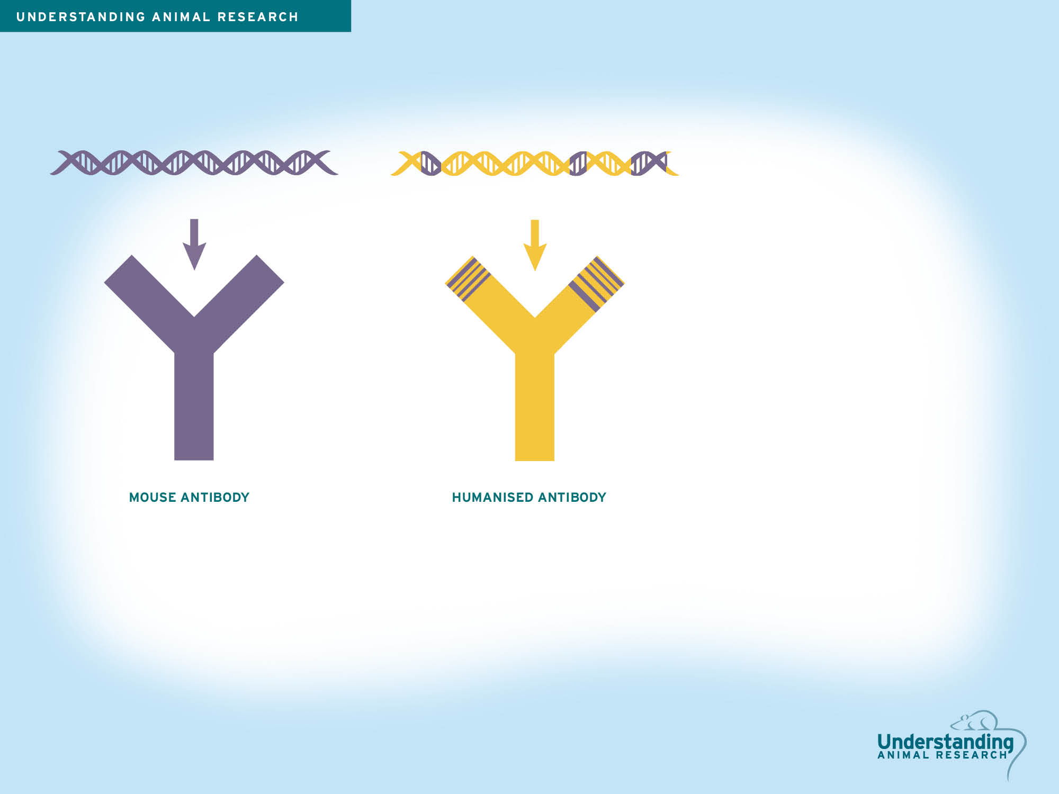
HERCEPTIN
If a mouse antibody is given directly to humans it can trigger an immune reaction. This is because the human immune system recognises that it is foreign. To avoid this, the genes for producing the Herceptin antibody are altered to make them more human-like.
Herceptin is made by DNA that is 95% human and 5% mouse. This is enough to trick the immune system into thinking that it is human and so ignoring it , but it keeps the important HER2 targeting section from the mouse at the tips of the antibody so it can bind to HER2.

Slide 9
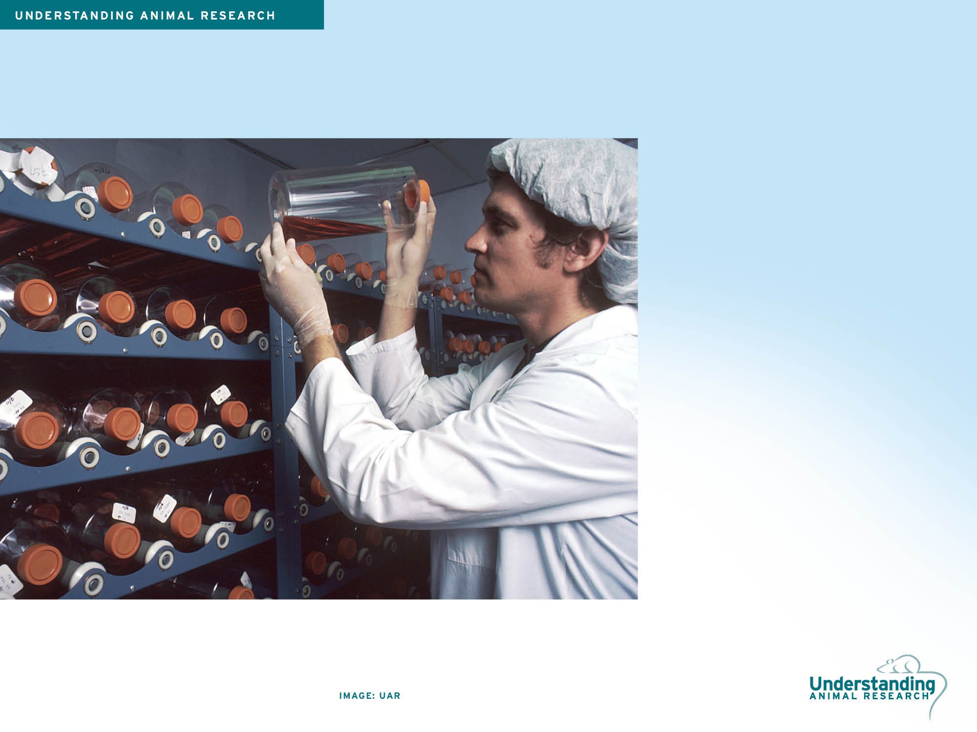
HERCEPTIN
The newly humanised gene for the antibody is then placed inside ovary cells taken from Chinese hamsters, a common set of cells used in research. These cells can be grown in unlimited amounts and the antibodies are extracted from them and given to patients.

Slide 10

HERCEPTIN
Herceptin was developed in 1991, but before it could be tested in humans it was important to understand how Herceptin behaves in a living system. Monkeys and mice were used to check if Herceptin was safe and to look for dangerous side-effects. Studies in cynomolgus monkeys showed that Herceptin can pass through to embryos or foetuses in pregnant patients and can also pass through to breast milk in nursing mothers. This means that Herceptin is not routinely recommended for women are pregnant or breastfeeding.

Slide 11
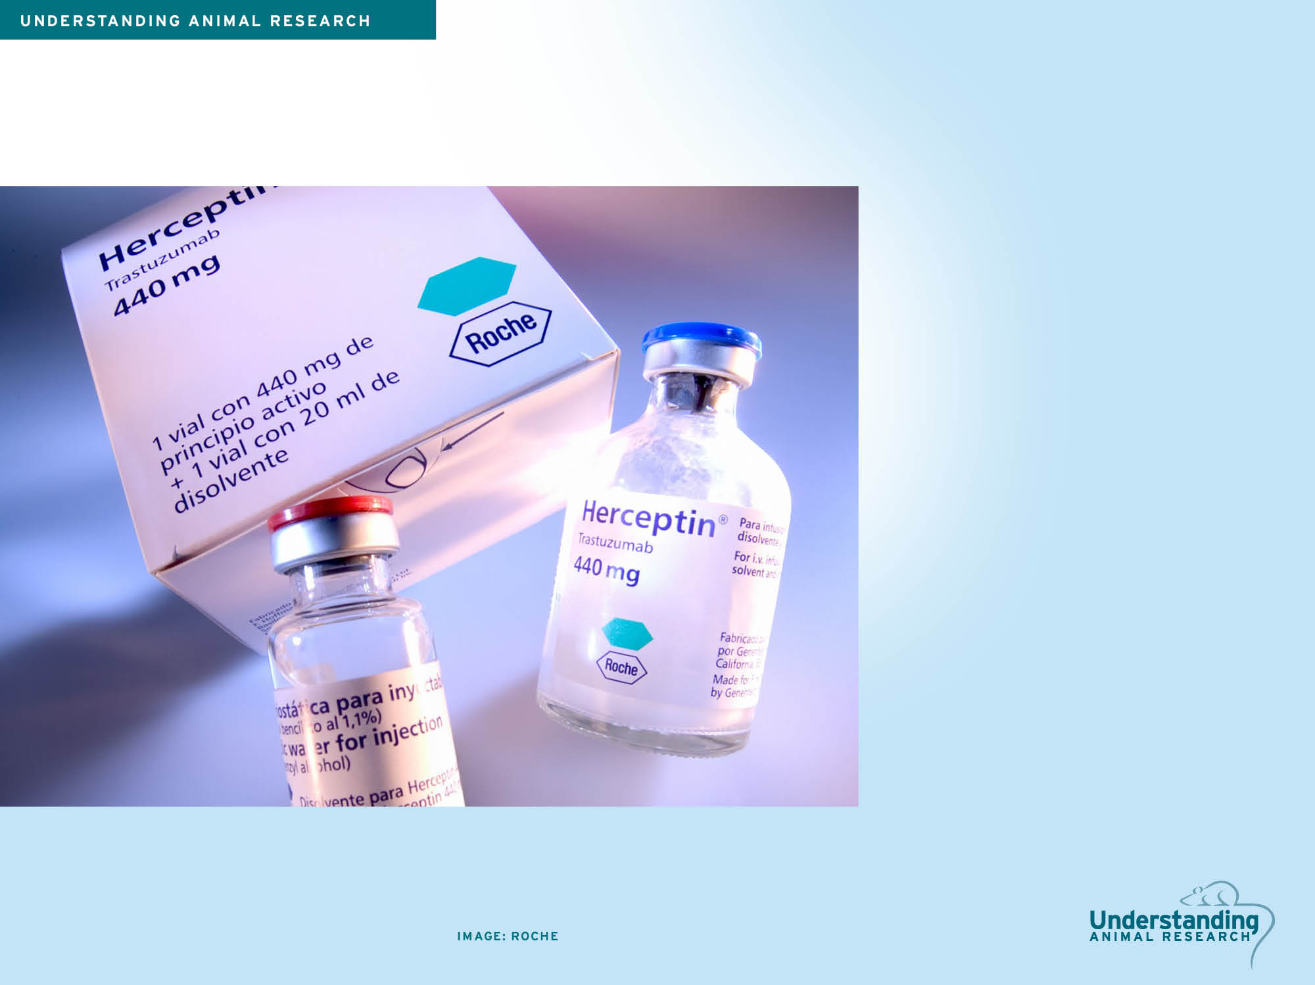
HERCEPTIN
Since 1998, Herceptin has been given to more than 1.3 million patients worldwide. Research continues to make it easier to administer the drug. In September 2013, a new formulation of Herceptin was approved in Europe that allows it to be given to patients by injection which takes about 5 minutes. Previously it was administered by intravenous drip, a process that can take up to 90 minutes.

